Slide 1

Employee Performance Dashboard
Power BI Project Presentation

Slide 2
Objective & Scope
Performance Analysis
KPI Monitoring
Analyze employee performance metrics across all departments to identify patterns and opportunities
Track critical HR and productivity indicators to measure organizational health and efficiency
Talent Insights
Strategic Decisions
Identify top performers and improvement areas to optimize workforce potential
Support data-driven HR decision making with actionable insights and clear visualizations

Slide 3
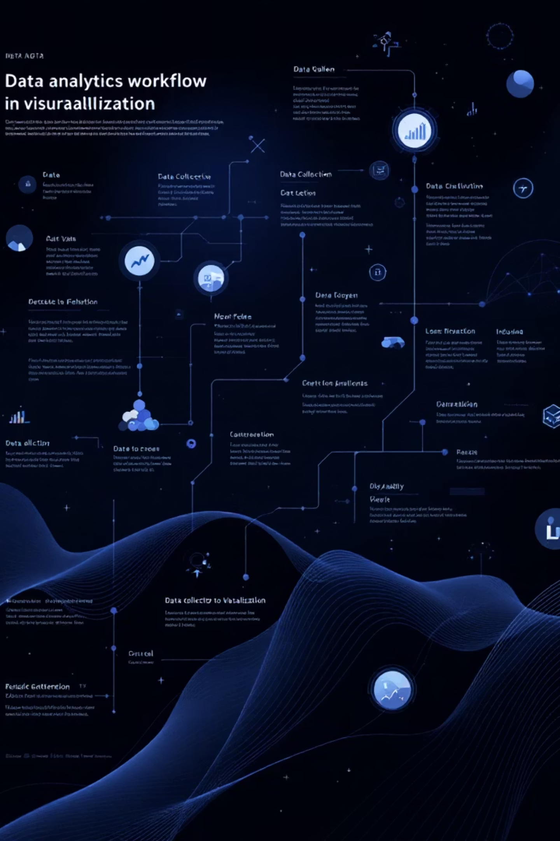
Data Source & Methodology
Data Foundation
Technical Approach
Employee HR records and performance data
Power BI Desktop for development
Comprehensive historical datasets
Advanced data cleaning and modeling
Real-time performance metrics
Custom DAX measures for calculations
Interactive visualizations and filters

Slide 4




Key KPIs Tracked
Employee Productivity
Attendance & Absenteeism
Training Hours Completed
Measuring output efficiency, goal achievement, and overall contribution to organizational objectives
Tracking presence patterns, sick days, and identifying potential engagement issues
Monitoring professional development investment and skill enhancement activities
Performance Ratings
Attrition Rate
Evaluating individual and team performance through structured assessment frameworks
Analyzing retention trends and identifying factors contributing to employee departure

Slide 5
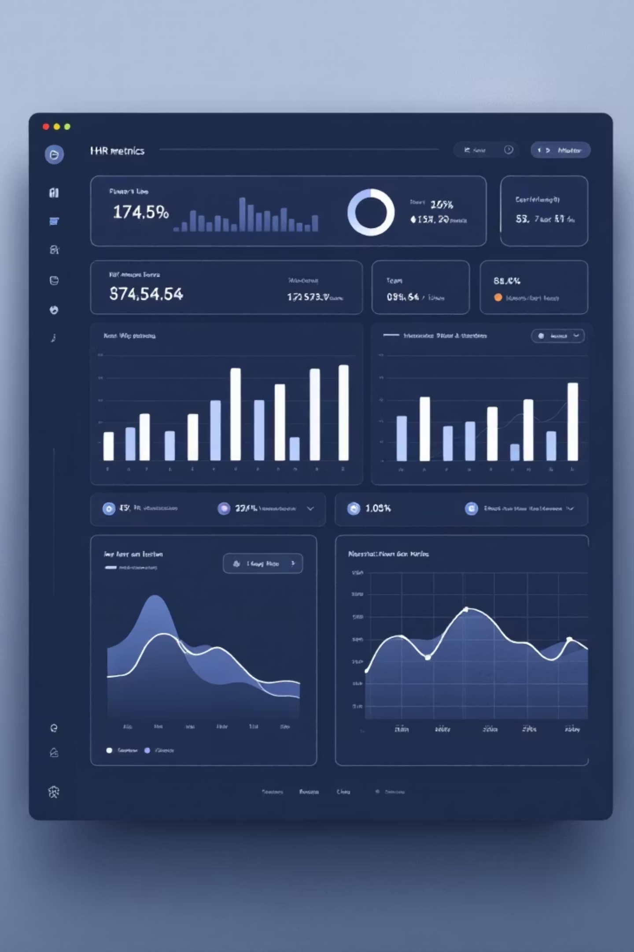

Dashboard Visuals
01
KPI Cards
Quick performance overview with key metrics at a glance for immediate insights
02
Department Charts
Comparative performance analysis across different organizational units
03
Monthly Trends
Time-series analysis showing attendance patterns and rating evolution
04
Retention Insights
Attrition analysis with predictive indicators and risk assessment

Slide 6

Key Findings
Top Performer Recognition
Identified high-achieving employees across all departments, revealing consistent patterns in productivity and quality metrics
Absenteeism Concerns
Discovered elevated absence rates in specific teams, indicating potential workload or engagement challenges
Training Impact
Strong correlation between training hours completed and improved performance ratings across all employee levels
Attrition Risk Patterns
Detected concerning turnover trends in specific roles, highlighting retention vulnerabilities

Slide 7
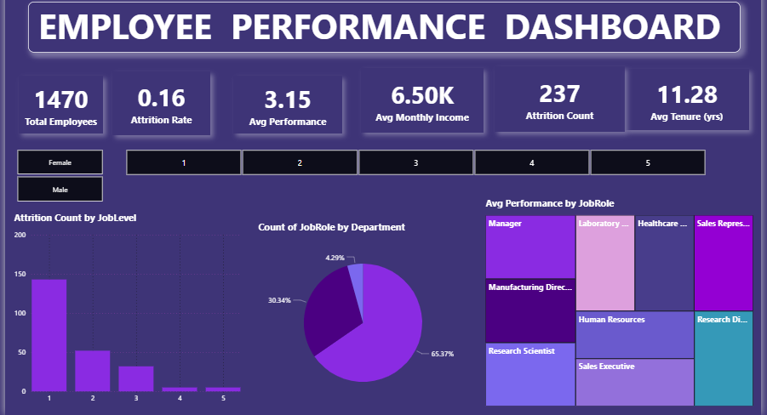

Slide 8




Conclusion & Recommendations
Recognize Excellence
Implement recognition programs for top performers to maintain motivation and set benchmarks
Address Absenteeism
Launch targeted HR initiatives including wellness programs and workload assessments
Expand Training
Increase investment in professional development programs to boost overall performance
Retention Focus
Develop specialized retention strategies for high-risk roles and departments

Slide 9
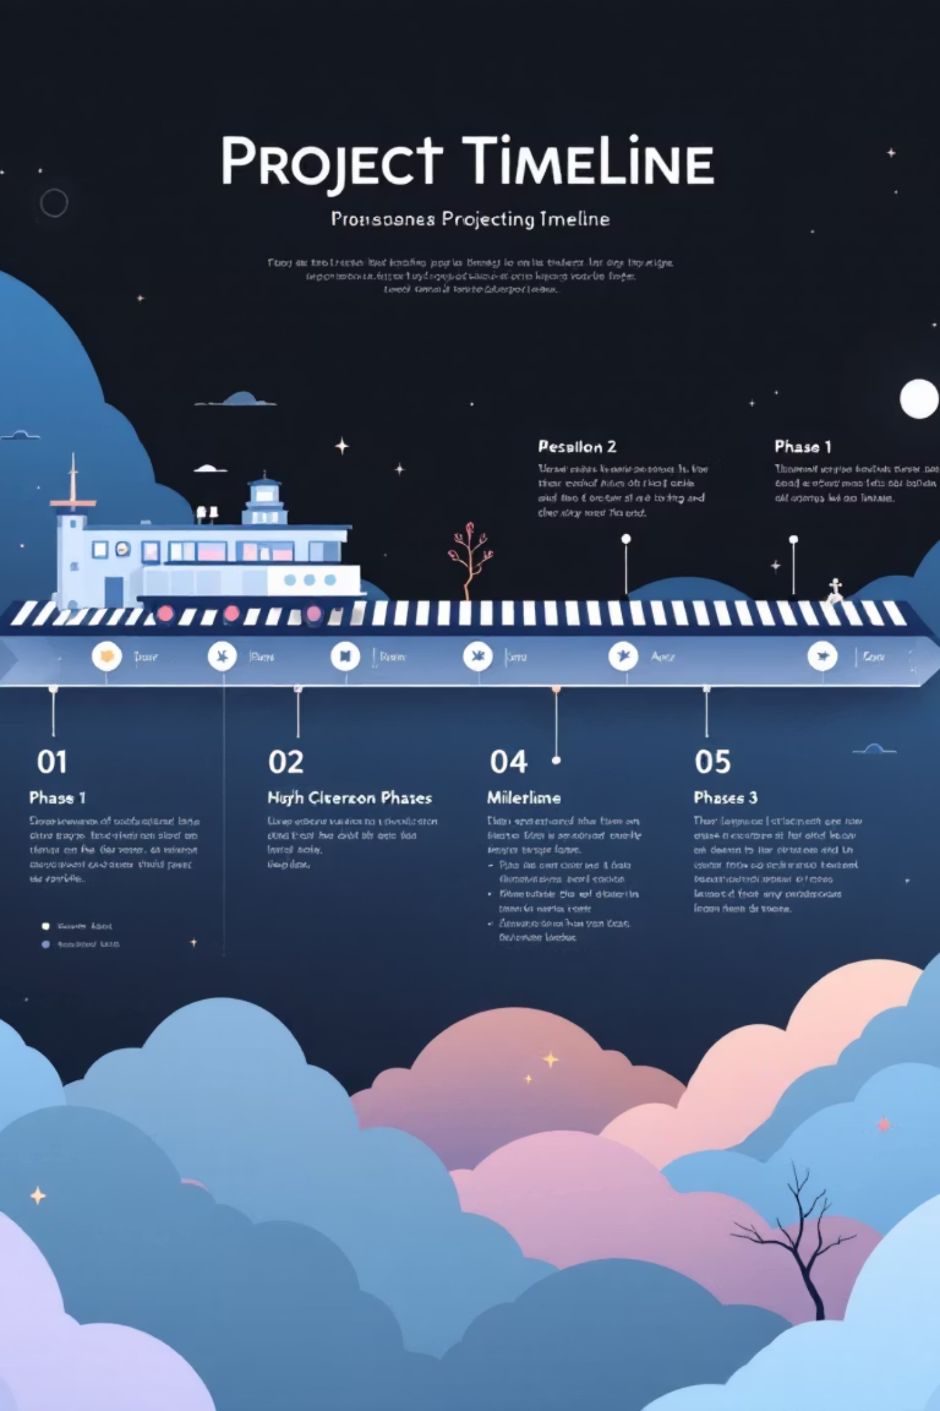
Implementation Timeline
1
Phase 1: Immediate Actions
Launch recognition program and begin absenteeism analysis within 30 days
2
Phase 2: Program Development
Design comprehensive training curricula and retention strategies over 60 days
3
Phase 3: Full Deployment
Roll out all initiatives and establish ongoing monitoring systems within 90 days
4
Phase 4: Continuous Improvement
Regular assessment and refinement of programs based on dashboard insights

Slide 10
Success Metrics & ROI
15%
25%
40%
20%
Productivity Increase
Absenteeism Reduction
Training Participation
Retention Improvement
Expected improvement in overall employee performance within six months
Increased engagement in professional development programs
Target decrease in unscheduled absences through wellness initiatives
Reduced attrition rate in high-risk roles and departments
These metrics will be continuously tracked through our Power BI dashboard, providing real-time visibility into program effectiveness and enabling agile adjustments to our HR strategy.

Slide 11

Thank You
Ready to transform HR decision-making with data-driven insights

